Slide 1
How to buy your first home – then pay that loan off!
A presentation to:
UC Alumni
23 October 2019
Presented by:
Michael Miller
BCom MBus CFP®
MLC Advice Canberra

Slide 2
Any advice in this publication is of a general nature only and has not been tailored to your personal circumstances. Please seek personal advice prior to acting on this information.
The information in this document reflects our understanding of existing legislation, proposed legislation, rulings etc as at the date of issue. In some cases the information has been provided to us by third parties. While it is believed the information is accurate and reliable, this is not guaranteed in any way.
GWM Adviser Services Limited ABN 96 002 071 749, trading as MLC Advice an Australian Financial Services Licensee, Registered office at 105 –153 Miller St North Sydney NSW 2060 and a member of the National Australia group of companies.

Slide 3
Step 1: Saving a Deposit
Notes:
(so here we have a creeping cat)
(channeling my inner Marie Kondo – inventor of the KonMari method)
Basic quality of life v lifestyle creep
If you want to identify lifestyle creep, consider looking at:
Anything on monthly subscription
Direct debits
Transaction histories
Leases

Slide 4
Beware the Lifestyle Creep!
The unnoticed accumulation of extra (and recurring) purchases to match growth of income…
…but these purchases bring little or no lasting joy.
Notes:
(so here we have a creeping cat)
(channeling my inner Marie Kondo – inventor of the KonMari method)
Basic quality of life v lifestyle creep
If you want to identify lifestyle creep, consider looking at:
Anything on monthly subscription
Direct debits
Transaction histories
Leases

Slide 5
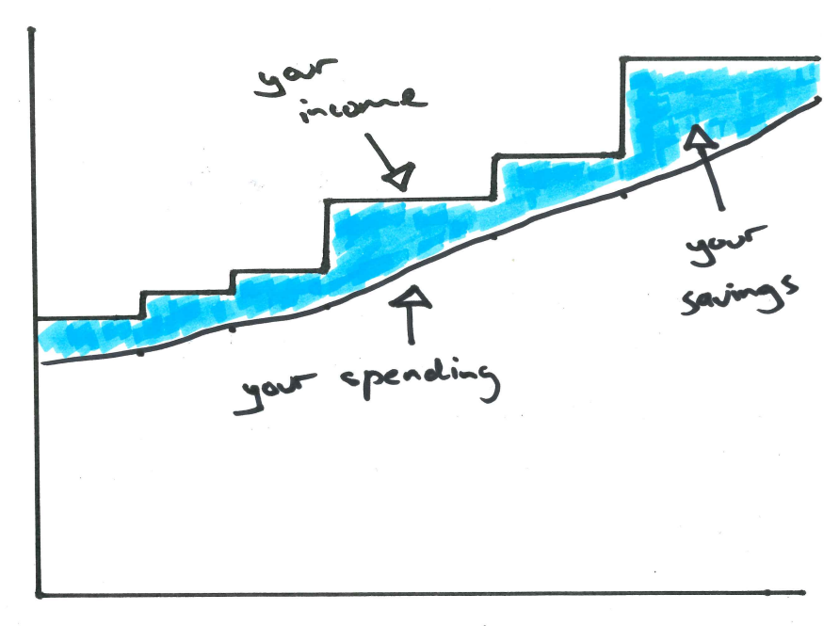
Savings with the Lifestyle Creep

Slide 6
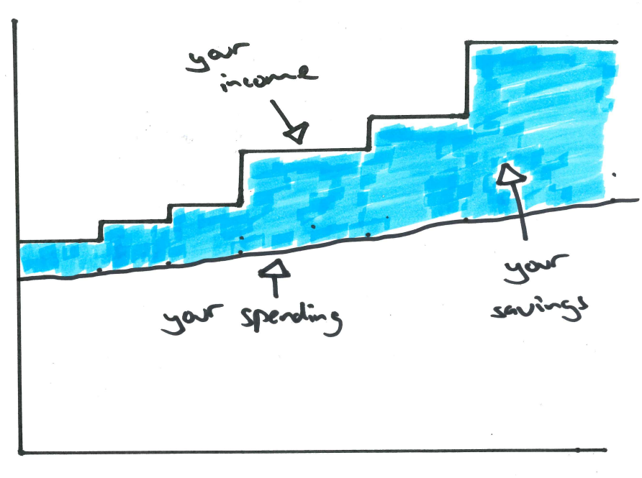
Less creep, more savings

Slide 7
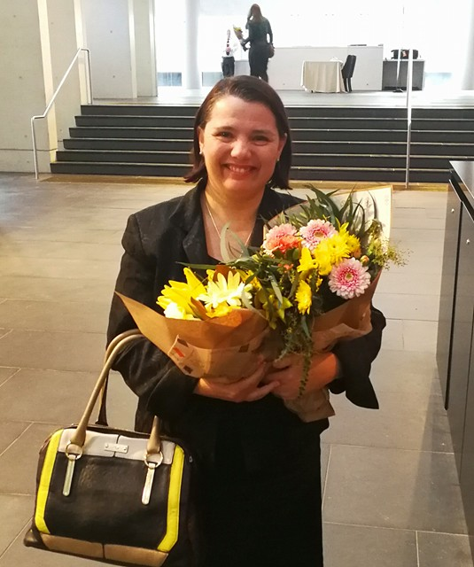
Goals, values, coffee & Serina
Notes:
It’s about working out what are your essentials, and what you consider optional.
Sometimes being a bit specific about what your goal is will give it extra “weight” which can help when having to make a choice between a longer term goal and a short term purchase – give yourself an endorphin kick for choosing your goal

Slide 8
The First Home Super Saver Scheme
…formerly known as the Financial Planner Full Employment Act 2017.
Withdraw extra, voluntary super contributions
To fund the purchase of a first home
(but not eligible if you’ve ever owned any property)
Contributions made from 1 July 2017 are eligible…
Notes:
https://www.aph.gov.au/Parliamentary_Business/Bills_Legislation/Bills_Search_Results/Result?bId=r5960

Slide 9
Why FHSSS?
You can contribute up to $15,000 a year (per person)
You can use pre-tax super contributions
(there’s often a significant tax saving)
You can accumulate up to $30,000 (per person)
Notes:
https://www.aph.gov.au/Parliamentary_Business/Bills_Legislation/Bills_Search_Results/Result?bId=r5960

Slide 10
FHSSS case study
Kelly is a recent graduate with a salary of $65,000 a year
Kelly has worked out that she can save $375 a fortnight out of her wages
(good work on the budgeting Kelly! that’s a savings rate of around 20%)
Kelly could actually salary sacrifice $575 a fortnight to her super
This would reduce her pay by the same(ish) $377 a fortnight…
Notes:
https://www.aph.gov.au/Parliamentary_Business/Bills_Legislation/Bills_Search_Results/Result?bId=r5960

Slide 11
FHSSS case study (continued)
This would reduce her pay by the same(ish) $377 a fortnight…
…but Kelly’s super (after contributions tax) account is growing by $488 every fortnight.
After two full financial years, Kelly would have saved $19,500 in her savings plan. But Kelly would have grown her super by $25,376 in the FHSSS.
(A FHSSS withdrawal would have $1,142 tax deducted)
So Kelly has an extra $4,734 for her deposit.
Notes:
https://www.aph.gov.au/Parliamentary_Business/Bills_Legislation/Bills_Search_Results/Result?bId=r5960

Slide 12
Step 1b: If You Have Personal Debt
Notes:
(so here we have a creeping cat)
(channeling my inner Marie Kondo – inventor of the KonMari method)
Basic quality of life v lifestyle creep
If you want to identify lifestyle creep, consider looking at:
Anything on monthly subscription
Direct debits
Transaction histories
Leases

Slide 13
Talk to a mortgage broker now
A mortgage broker knows a wide range of lenders, their policies, and how they assess loans.
Will be able to help you work out if your application is better:
With a bigger deposit, but existing loans; or
With the existing loans repaid, but a lower deposit

Slide 14
We work with humans
(they’re much nicer)
v

Slide 15
Step 2: Paying Off Your Loan
Notes:
(so here we have a creeping cat)
(channeling my inner Marie Kondo – inventor of the KonMari method)
Basic quality of life v lifestyle creep
If you want to identify lifestyle creep, consider looking at:
Anything on monthly subscription
Direct debits
Transaction histories
Leases

Slide 16
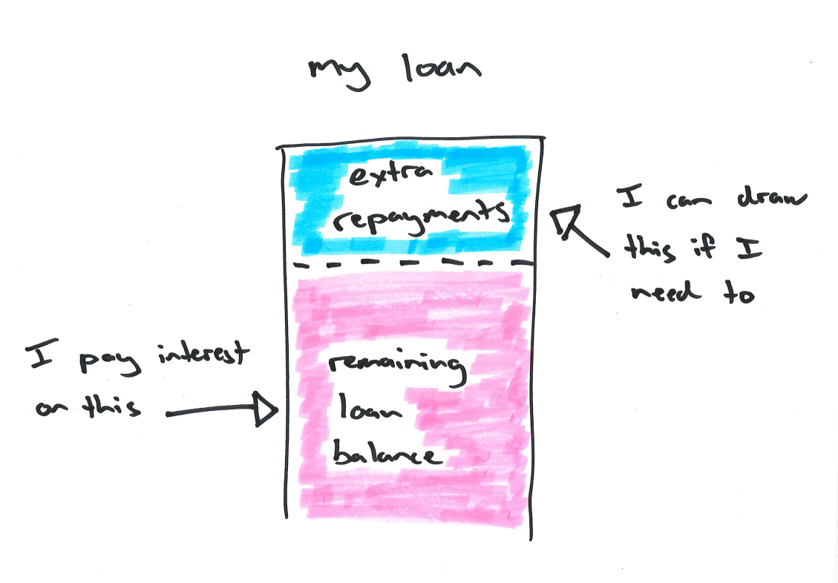
A redraw account

Slide 17
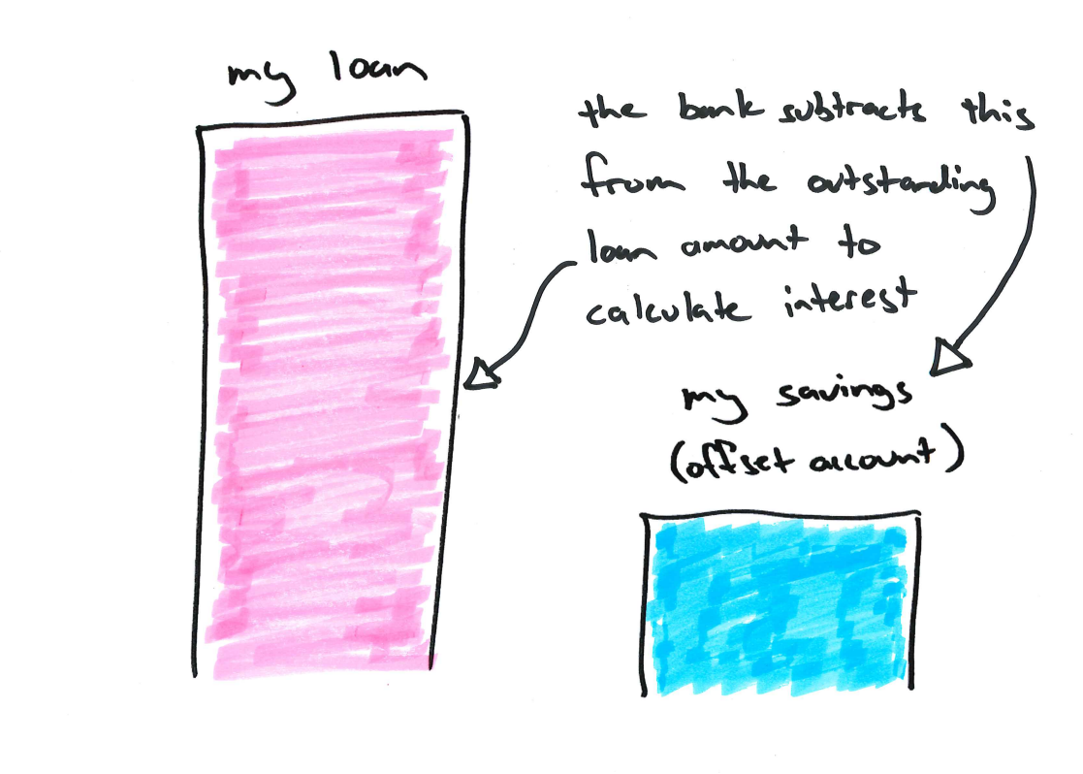
An offset account

Slide 18
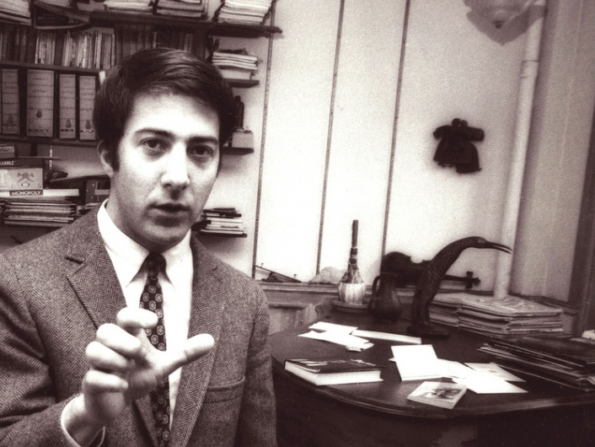
Be like Dustin?
Notes:
Gene Hackman and Dustin Hoffman were friends back in their starving artist days, and Hackman tells the story of visiting Hoffman’s apartment and having his host ask him for a loan.
Hackman agreed to the loan, but then went into Hoffman’s kitchen, where several mason jars were lined up on the counter, each containing money.
One jar was labelled “rent”, another “utilities,” and so forth. Hackman asked why, if Hoffman had so much money in the jars, he could possibly need a loan, whereupon Hoffman pointed to the food jar, which was empty.

Slide 19
The mason jars approach
Notes:
But if you take care of the contributions for essential expenses.
And future expenses (repaying debts, having money for retirement, paying for kids’ education).
Then maybe it’s ok to spend what’s left over without counting or recording it.
…I think you’ll find there is irrefutable proof that the mental accounting / savings jars approach works.
Because Dustin Hoffman is now very rich.

Slide 20
Eliminate bill shock
Rent
Contents insurance
Notes:
Life used to be easy.
You were paid every fortnight.
You rented a place, or a room, and you paid fortnightly.
Maybe you had a little bit of contents insurance… if you had contents worth insuring.
When something went wrong – you called the property manager and they organised a repair.

Slide 21
Eliminate bill shock
Mortgage repayments
Rates
Health insurance
Building insurance
Utilities (elec, gas & water)
Income insurance
School fees
Notes:
But life gets a bit more complicated.

Slide 22
Create your own Property Manager account
Mortgage repayments
Rates
Health insurance
Building insurance
Utilities (elec, gas & water)
Income insurance
School fees
Notes:
You can re-create your own Property Manager!
Just set up a separate account for all the big stuff.
Make a considered estimate of what your big stuff might add up to over the course of a year. Divide it by 26 (if you’re paid fortnightly) and then put this amount every fortnight into your DIY Property Manager account.
It’s ideal if you can kick it off with a bit of a lump sum – consider using amounts like a bonus or a tax refund.
Remember to increase your Property Manager’s budget a little each year – you can be sure the bills will be increasing.
Your Property Manager can make it possible to take advantage of significant savings such as reduced fees or premiums for annual payments. Once you’ve got a good buffer you can also use direct debits and never pay another late fee.

Slide 23
Paying your loan down, faster
Be aware of Lifestyle Creep
Have a system in place, to pay for the essentials
If early repayment is a goal you have – name it
Use some of your “free money” – tax refunds, bonuses, and other windfalls to make extra repayments
Start small, but get started – momentum is powerful

Slide 24
Get in touch
Michael Miller
MLC Advice Canberra
(02) 6247 1233
www.michaelmiller.help

Slide 25
LOAN MARKET NITISH KUMAR

Slide 26
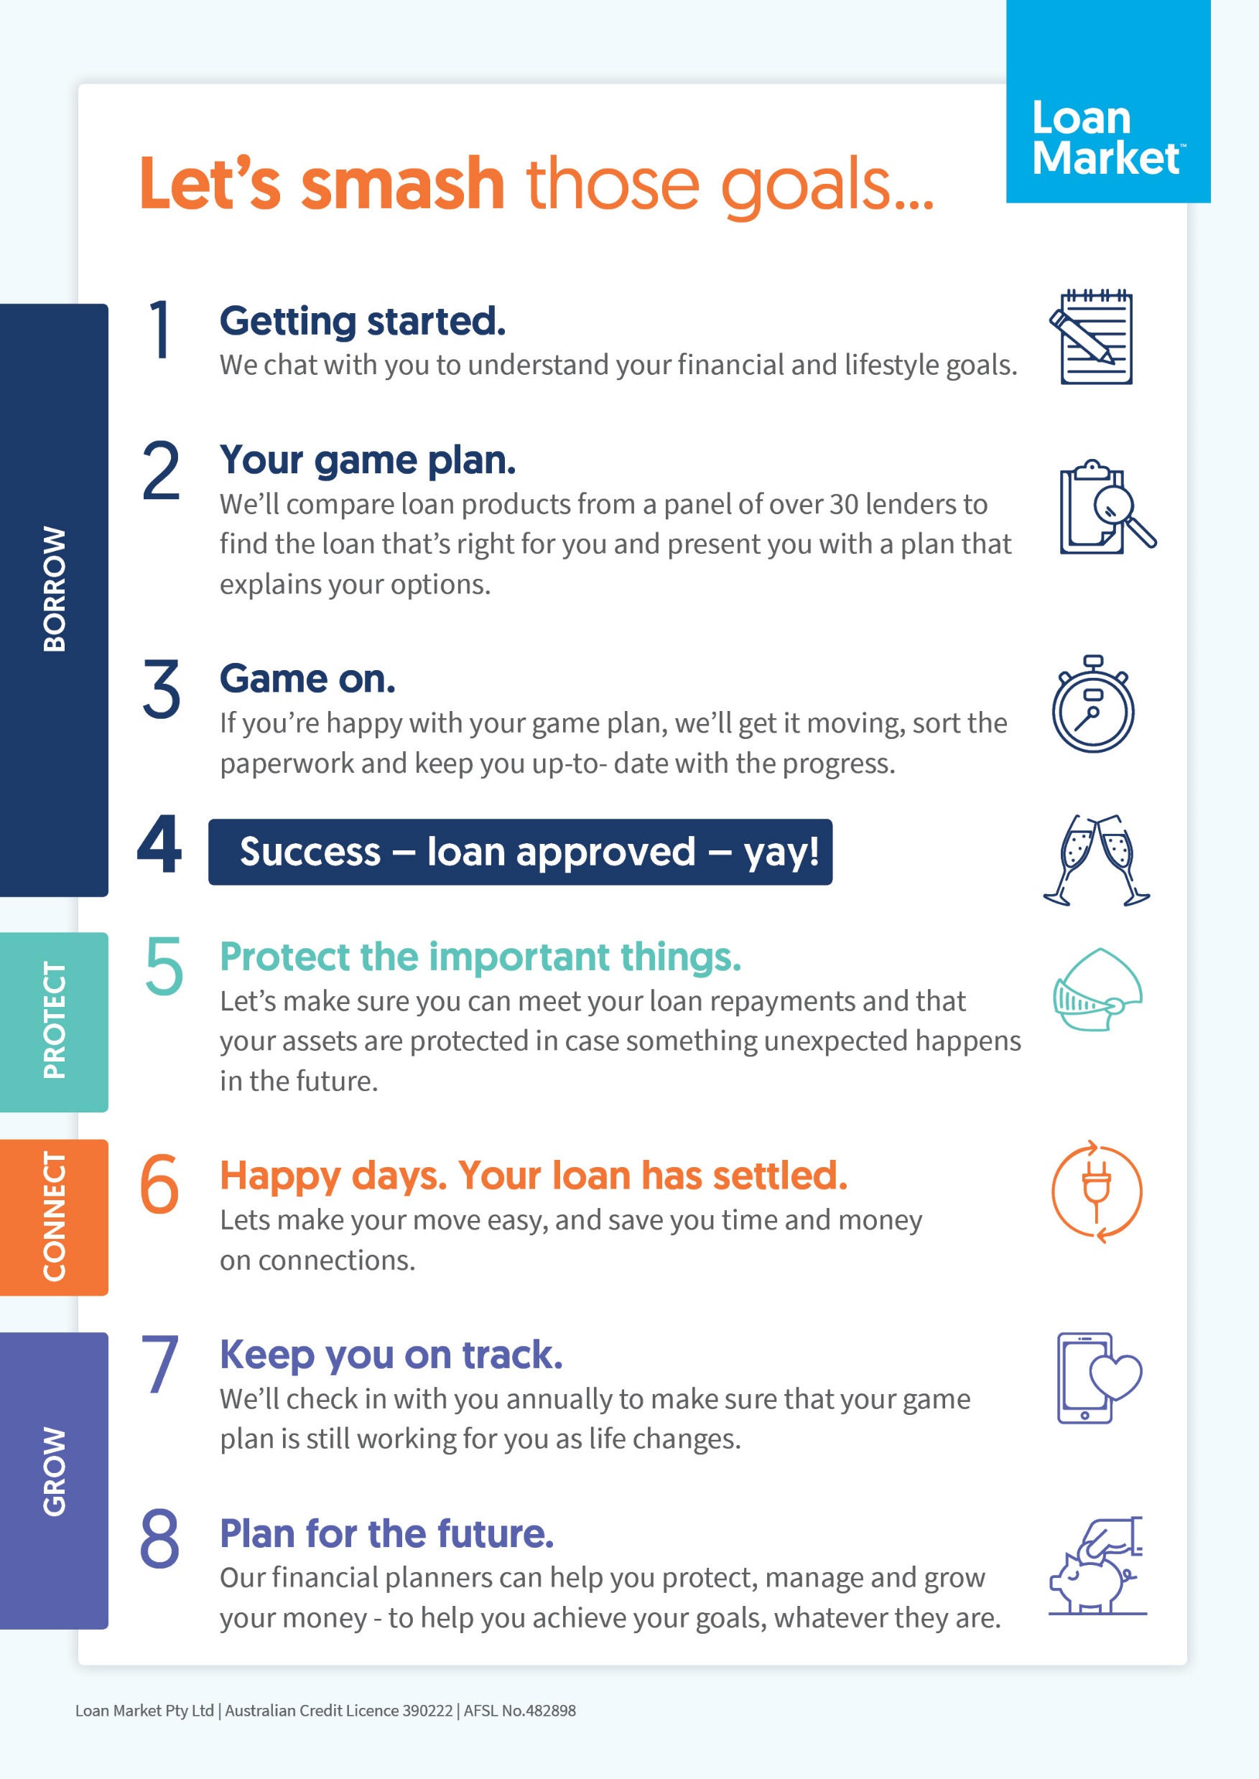
What does a mortgage broker do?

Slide 27
ACT Home Buyers Concession
All Buyers of the home must be 18 years old
Total gross income of all buyers to be under $160,000 (additional $3,300 per dependant)
All buyers including their partner must not have owned any other properties in the last 2 years
At least one buyer must live in the home continuously for at least one year, starting within 12 months of settlement or completion of construction
NO PRICE RESTRICTIONS

Slide 28
NSW Home Buyers Concession
All Buyers of the home must be 18 years old
No Income Threshold
All buyers including their partner must not have owned any property before
At least one buyer must live in the home continuously for at least 6 months, starting within 12 months of settlement or completion of construction
House – No Stamp Duty up to $650,000 and concessional stamp duty between $650,000 - $800,000
Land – No Stamp Duty up to $350,000 and concessional stamp duty between $350,000 - $450,000

Slide 29
NSW First Home Owner Grant - $10,000
All Buyers of the home must be 18 years old
No Income Threshold
All buyers including their partner must not have owned any property before
At least one buyer must live in the home continuously for at least 6 months, starting within 12 months of settlement or completion of construction
ONLY available on new properties
House – No more than $600,000
Land & Build Contract – No more than $750,000 combined

Slide 30
The Next Step
Get in touch with us to talk about your home loan options:
Nitish Kumar
0412 136 603
Nitish.kumar@loanmarket.com.au
www.loanmarket.com.au/Nitish-kumar

